Slide 1
Prediction of car fuel consumption
ReGeneration Academy on Data Science
(Powered by Papastratos October 2021)

Slide 2
Team presentation
Data Scientist Team 7
Thanos
Vasilas
Panagiotis
Panagos
Alexandros Tatsis
Maria
Hatzigeorgiou
Georgios
Theodosiadis

Slide 3
Presentation structure
Data Presentation
Visualization before preprocessing
Best model
Data Preprocessing
Visualization after preprocessing
Creation and evaluation of models
Project Scope & Deliverables

Slide 4

Project Scope & Deliverables
Creation of a model for predicting the Miles per gallon value.
Power BI for Data Exploration
Python Notebook with Data Preprocessing and Model Development

Slide 5
Data presentation
Mpg
Cylinders
Horsepower
Weight
Car name
Acceleration
Model year
Origin
Displacements

Slide 6
Process
Data exploration
Data cleaning-
Data Preprocessing
Visualization for better comprehension
ML process
Visualization

Slide 7
Data exploration
Origin
Cylinders
Horsepower
Weight
Acceleration
Model Year
Car Name
Three Geographical Areas (1,2,3)
Discrete number: 3,4,5,6,8
Continuous: 46-230 hp
Continuous: 1.6 – 5.2 tons
Continuous: 8.0 – 24.8 sec
Discrete: 70-82
String: 406 Car Company plus Car Model
Displacements
Continuous: 68 – 455 ci

Slide 8
Data exploration
NaN values
8 missing values in Miles per Gallon
6 missing values in Horsepower
Wrong values
Wrong car names

Slide 9
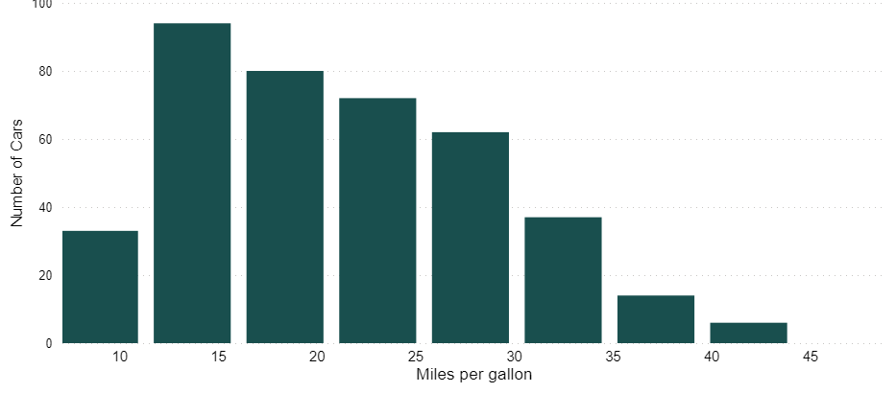
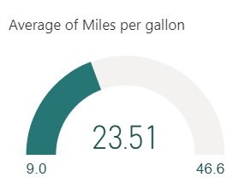
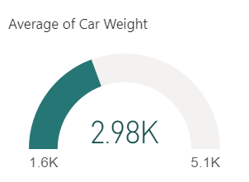
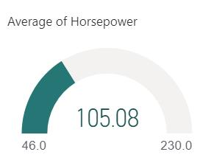
Visualization before preprocessing

Slide 10
Data cleaning & Data Preprocessing
NaN values
Deletion of rows containing MPG missing values (Target variable)
Replacement missing HORSEPOWER values with median of total horsepower values
Wrong values
Correction of wrong Car names
e.g. maxda-> mazda , toyouta -> Toyota
Outliers:
Withdrawal values outside Q=0.10 & Q=0.90
New column: Car Company
Splitting Car name column to Car company and Car model
e.g. toyota corona mark ii –> toyota, corona mark ii

Slide 11
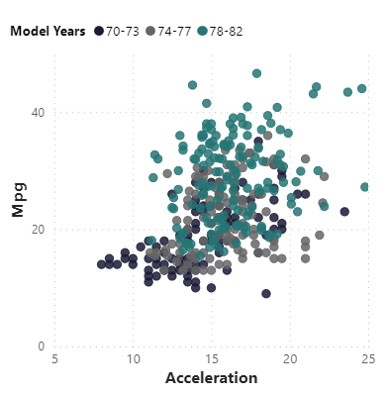
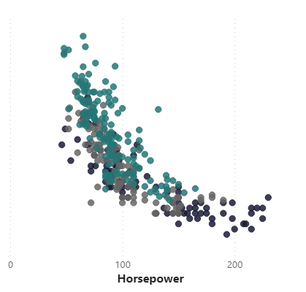
Visualization after preprocessing

Slide 12
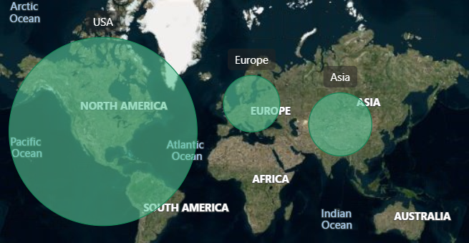
70
249
79

Slide 13
Prediction Models
Regression Models
Decision Tree Regressor
Lasso
Linear
K Neighbors Regressor
Random Forest Regressor
R2 metric,
R-Squared is a statistical measure of fit that indicates how much variation of a dependent variable is explained by the independent variable(s) in a regression model.

Slide 14
Prediction Results (Kneighbors Regressor)
Best Model:
KNeighbors with the appropriate parameters
Scores:
Selected Features:
Actual mpg value | Prediction mpg value | Error
23.8 | 23.3 | -0.5
34.4 | 34.1 | -0.3
24.5 | 27.2 | 2.7
34.7 | 34.6 | -0.1
14.0 | 14.2 | 0.2
19.9 | 21.1 | 1.2
17.5 | 18.9 | 1.4
29.0 | 28.6 | -0.4
Origin
Acceleration
Horsepower
Cylinders
Model Year
Displacements
Weight
Car Company
Car Model
R2 | 0.906
MAE | 1.747
RMSE | 2.246
Model application:
With the usage of predictmpg function in the D06 file. Argument:
A (1,9) float64 array containing (cylinders, displacements, horsepower,
weight, model year, acceleration, origin(0,1 for each of USA, Europe, Japan)

Slide 15
Extensions
Some thoughts for further future improvement:
Check the model with more recent data and re-evaluate.
Prediction Model by car category
Separation of cars in “small”, “middle” and “huge” category according to their technical features.

Slide 16

Do you have any questions?

